Slide 1

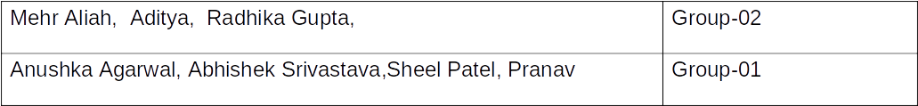
Atal Bihari Vajpayee-
Indian Institute of Information Technology and Management Gwalior
Computer Graphics Lab : 10
Lighting & Shading Models
Instructor – Dr. Sunil Kumar
Assistant Professor @ Dept. of Information Technology, ABV-IIITM Gwalior
Teaching Assistants (TAs)

Slide 2
Objective of this lab
To study and implement various lighting and shading models in computer graphics, including Flat, Gouraud, and Phong shading, and Ray Tracing, while applying 3D transformations to objects and comparing their visual effects on rendered scenes.

Slide 3
Demo Assignment - 01
#include <GL/glut.h>
float angle = 0;
void display() {
glClear(GL_COLOR_BUFFER_BIT | GL_DEPTH_BUFFER_BIT);
glLoadIdentity();
glTranslatef(0, 0, -4);
glRotatef(angle, 1, 1, 0);
glEnable(GL_LIGHTING);
glEnable(GL_LIGHT0);
glEnable(GL_DEPTH_TEST);
glShadeModel(GL_FLAT);
GLfloat light[] = {2, 3, 4, 1};
glLightfv(GL_LIGHT0, GL_POSITION, light);
glutSolidCube(1.0);
glutSwapBuffers();
}
void update(int) {
angle += 1;
glutPostRedisplay();
glutTimerFunc(16, update, 0);
}
int main(int argc, char** argv) {
glutInit(&argc, argv);
glutInitDisplayMode(GLUT_DOUBLE | GLUT_RGB | GLUT_DEPTH);
glutInitWindowSize(600, 600);
glutCreateWindow("Flat Shading - Rotating Cube");
glMatrixMode(GL_PROJECTION);
gluPerspective(45, 1, 1, 100);
glMatrixMode(GL_MODELVIEW);
glutDisplayFunc(display);
glutTimerFunc(0, update, 0);
glutMainLoop();
return 0;
}

Slide 4
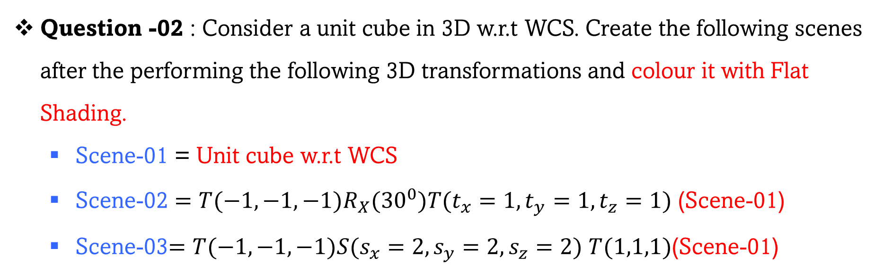
Assignment - 02

Slide 5
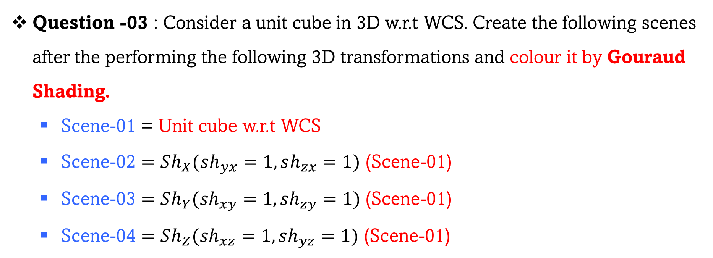
Assignment - 03

Slide 6
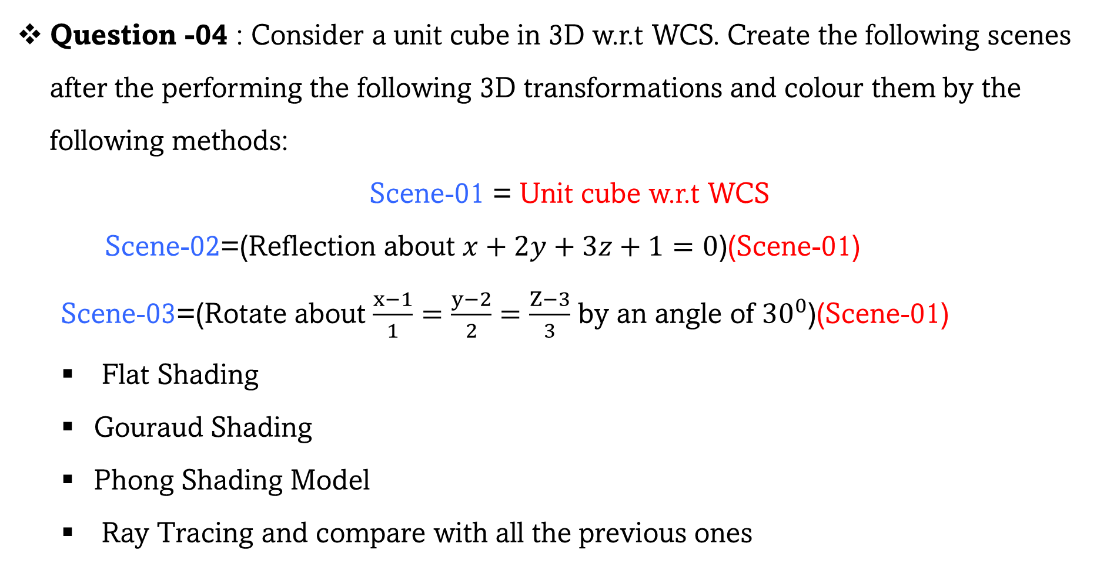
Assignment - 04

Slide 7
Assignment - 05
Question -05 : Create a scene of your interest and colour it.
YOUR SCENE

Slide 8
Thank you !

